Slide 1
WEAVING DIGITAL / LEARNING
UNSCHOOLING LEARNING

Slide 2
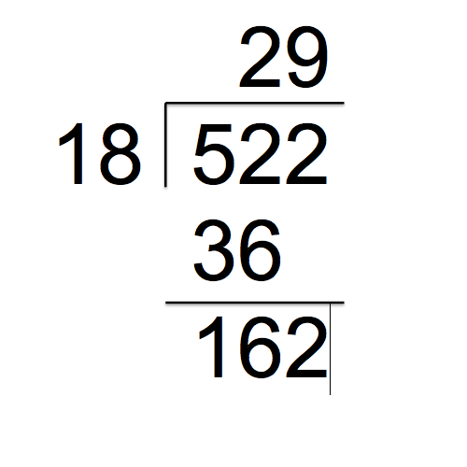

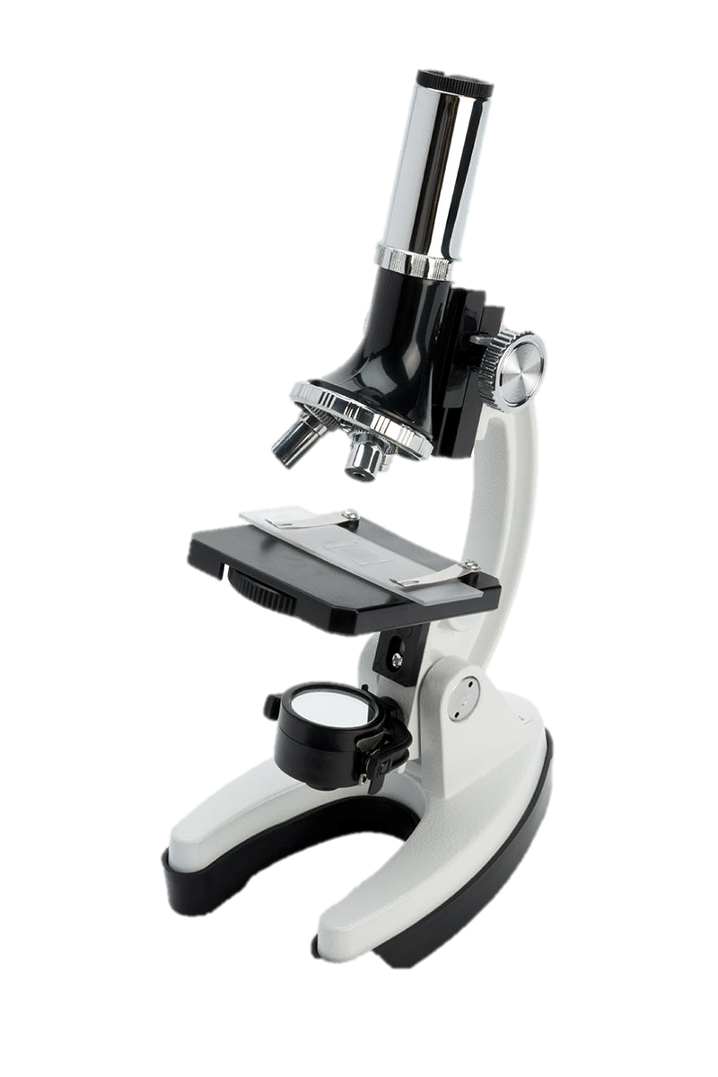
School...

Slide 3
School...
is a good
launching pad,

Slide 4
School... is a good launching pad, but the journey is up to us.

Slide 6
Curiosity
Effectiveness
Responsibility

Slide 7
Learning wish list...

Slide 8
Learning wish list...
I wish I could keep track really efficiently of new news about this topic.
I wish I could get the particulars of this idea into my head so that they stick.
I wish I could keep such-and-such a principle top-of-mind enough so I’d put it to work rather than just knowing about it.

Slide 9
Learning wish list...
I wish I could keep track really efficiently of new news about this topic.
I wish I could get the particulars of this idea into my head so that they stick.
I wish I could keep such-and-such a principle top-of-mind enough so I’d put it to work rather than just knowing about it.
I wish I could.......................................................................
I wish I could......................................................................................
I wish I could...............................................
I wish I could.....................................................................................
I wish I could..........................................................................
I wish I could..........................................................................................
I wish I could.............................................................................................
I wish I could..........................................................................
I wish I could.............................................................................................
I wish I could..............................................................................................
I wish I could..........................................................................................
I wish I could...................................................................................................
I wish I could........................................................................
I wish I could....I wish I could...

Slide 10
LEARNING LOGISTICS
LEARNING SCIENCE
LEARNING DISTRIBUTED
LEARNING JOURNEYS

Slide 11

LEARNING LOGISTICS

Slide 12
Their topics → My topics
(problem: selection)
Their rhythm → My rhythm
(problem: neglect)
Print → Digital
(problem: digital sprawl)
Bandwidth for information → Bandwidth for action
(problem: keeping action fronts in mind)

Slide 13
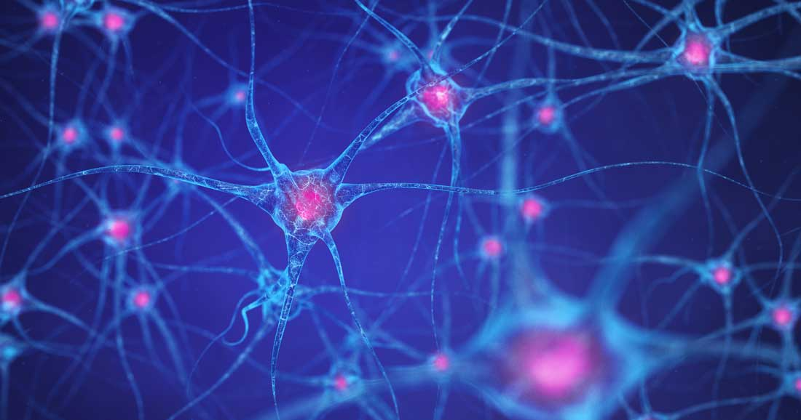
LEARNING SCIENCE

Slide 14
Fixed mindset → Growth mindset Carol Dweck
(illusion: you either get it or you don’t)
Learning about → Learning to do
(illusion: actionability)
Focused framing → Expansive framing Randi Engle
(illusion: effortless transfer)
One big push → Over time
(illusion: what’s clear now sticks)

Slide 15
LEARNING DISTRIBUTED

Slide 16
LEARNING DISTRIBUTED
Distributed Cognitions Distributed Intelligence Extended Cognition “Person Plus”

Slide 17
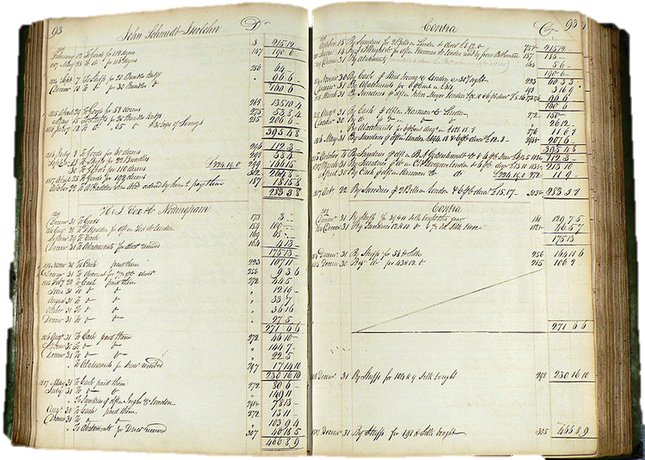
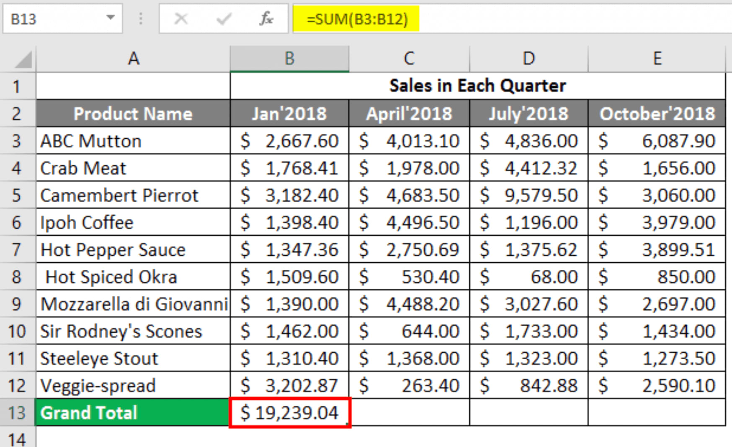
In my head → plus Right in front of me
(challenge: fluent workspaces)

Slide 18
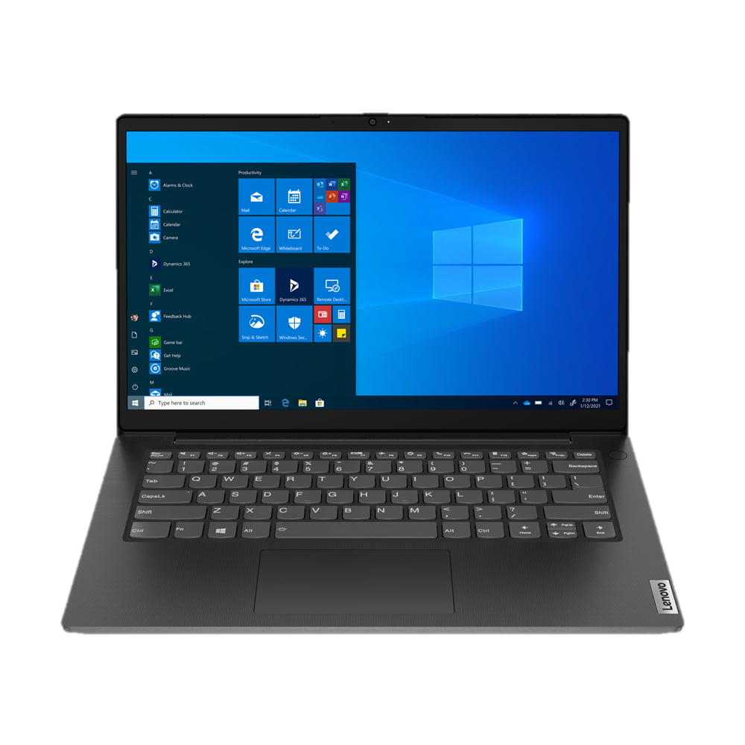
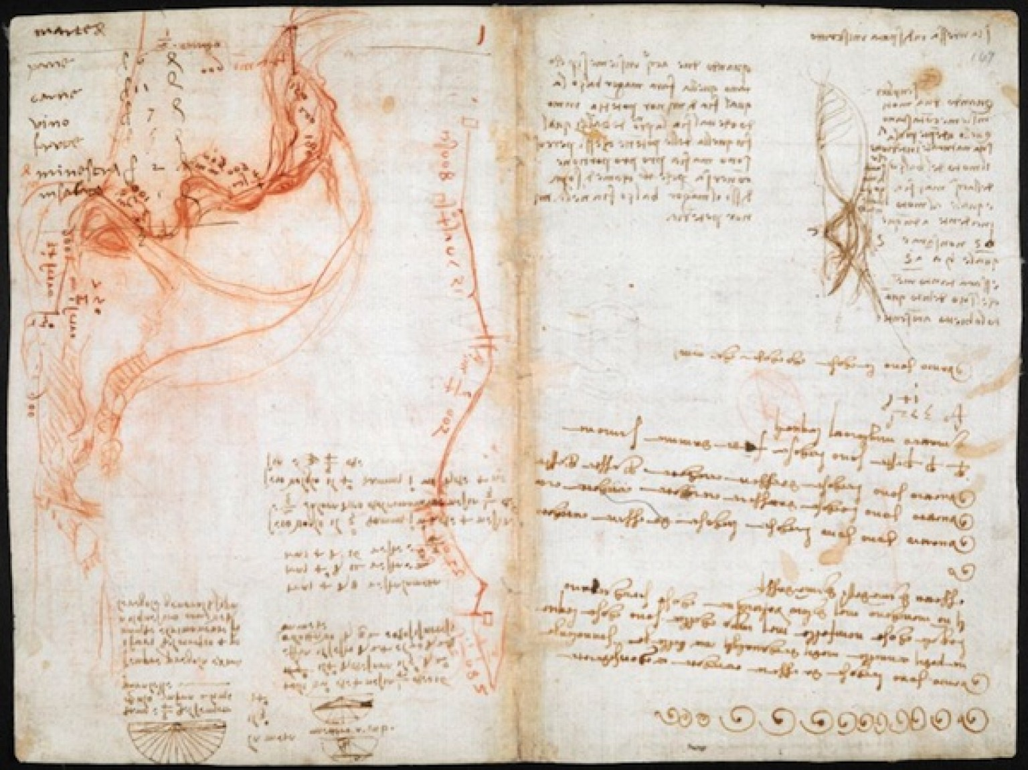
In my head → plus Easy reach
(challenge: building personalized knowledge resources)

Slide 19


In my head → plus Out there somewhere
(challenge: knowing where and how to look)

Slide 20
But is this learning?
The “Person Plus” system learns
And the process helps my head to learn...
By absorbing info through organizing it
To personalize the system better for me
To work with my personalized system fluently
To access resources beyond the personalized system

Slide 21

LEARNING JOURNEYS

Slide 22
Unschooling Learning

Slide 23
School is a good launching pad, but the journey is up to us.

Slide 24
Learning wish list...
I wish I could keep track really efficiently of new news about this topic.
I wish I could get the particulars of this idea into my head so that they stick.
I wish I could keep this principle top-of-mind enough so I’d put it to work rather than just knowing about it.

Slide 25
Learning logistics
Managing topics, organization, digital sprawl, bandwidth for action
Learning science
Cultivating a growth mindset, learning to do, expansive framing, learning over time
Learning distributed
With traditional and new technologies greatly expanding our “person plus”

Slide 26
The journey is up to us
empowered by our many ways of weaving digital

